Slide 1

Netflix Movie Data Analysis
Uncovering insights from movie ratings, genres, and popularity trends to drive engagement and improve content strategy

Slide 2
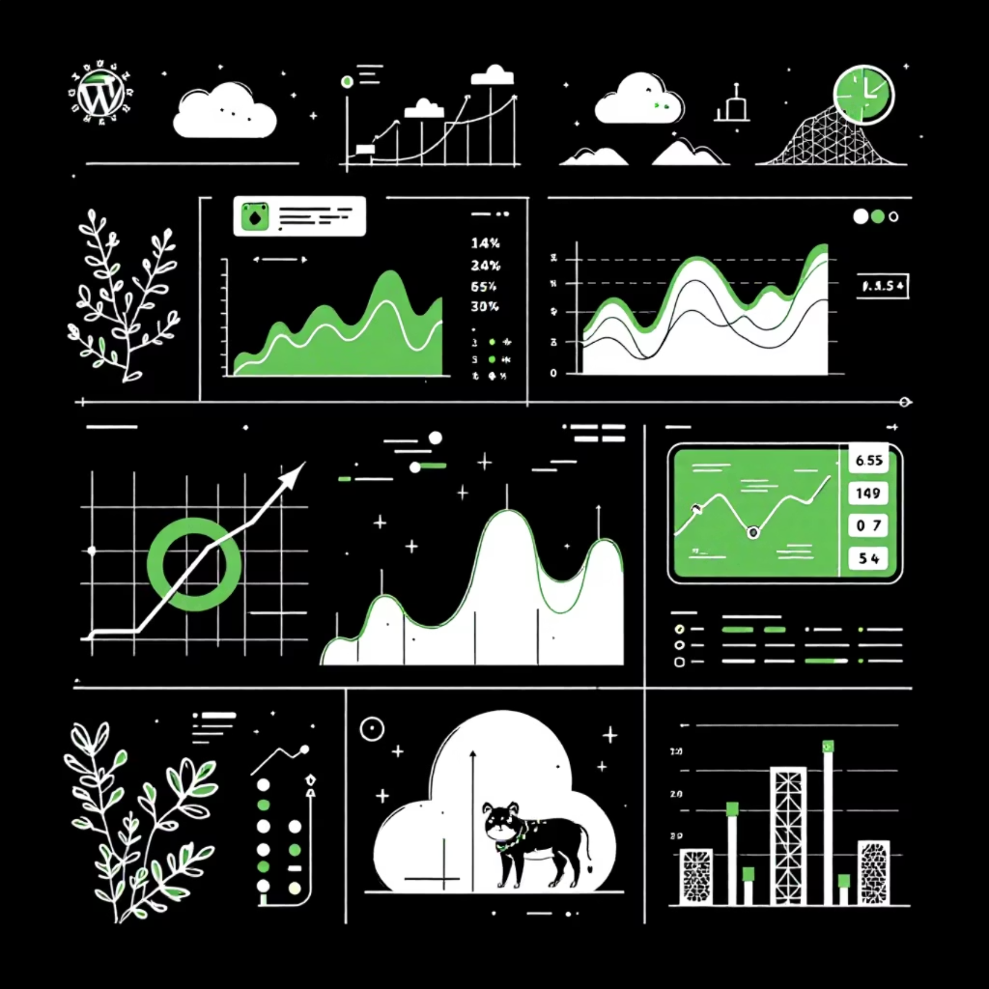
Project Overview
This project analyzes Netflix movie data using Python to uncover patterns in ratings, genres, and popularity. Through data cleaning, transformation, and exploratory analysis, we identify viewer preferences and content performance trends.
The analysis supports data-driven decisions to enhance user engagement, improve recommendation strategies, and build trust within the Netflix community.

Slide 3

Key Objectives
Rating Analysis
Categorization
Analyze movie ratings and popularity patterns across the platform
Categorize movies using statistical quartiles based on vote averages
Genre Normalization
Trend Identification
Normalize multi-genre movies for accurate genre-wise analysis
Identify trends in audience preferences and viewing behavior

Slide 4

Technology Stack
Python & Pandas
Core language for data manipulation and analysis with powerful DataFrame operations
Matplotlib & Seaborn
Advanced data visualization libraries for creating insightful charts and graphs
Jupyter Notebook
Interactive environment enabling exploratory analysis and documentation

Slide 5

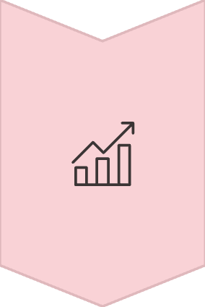

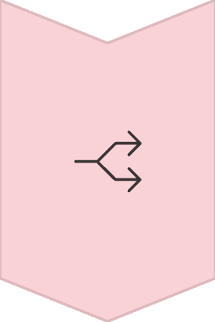
Data Preprocessing Pipeline
Data Cleaning
Handled missing values and converted columns to appropriate data types
Transformation
Converted Vote_Average into categorical popularity segments using quartiles
Normalization
Split and exploded Genre column for accurate multi-genre analysis

Slide 6
Movie Popularity Categories
Movies were categorized into four distinct popularity segments based on statistical quartile analysis of vote averages.
Not Popular
Lowest quartile of ratings
This quartile-based approach simplifies interpretation and enables clear identification of high and low-performing content.
Below Average
Second quartile range
Average
Third quartile performance
Popular
Top quartile of content

Slide 7
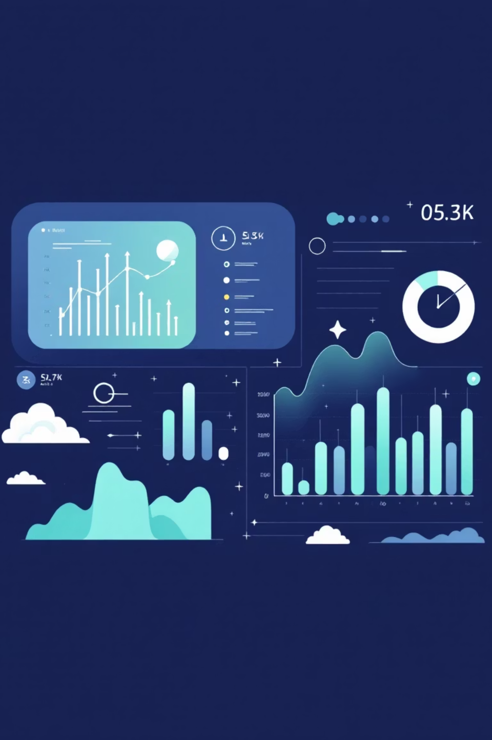
Key Insights Discovered
Rating Distribution
Genre Performance
Majority of movies fall within average and below-average rating categories, indicating room for content quality improvement
Certain genres consistently receive higher ratings, revealing strong audience preferences and content opportunities
Analysis Accuracy
Genre normalization significantly improved the accuracy of genre-level analysis by properly accounting for multi-genre titles

Slide 8




Exploratory Data Analysis
Rating Distribution
Genre Analysis
Analyzed patterns across all movie ratings to identify concentration areas
Examined genre-wise popularity and frequency to understand preferences
Viewer Patterns
Performance Metrics
Studied preference patterns based on ratings and genre combinations
Identified high and low-performing genres for strategic insights

Slide 9
Future Recommendations
01
02
03
Enhanced Personalization
Content Monitoring
Transparency & Trust
Develop recommendation systems using genre and rating insights to improve user experience
Track low-performing content and identify improvement opportunities through data-driven analysis
Increase transparency around ratings and recommendations to build stronger user trust
04
05
User Feedback Integration
Predictive Modeling
Incorporate engagement metrics and user feedback into ongoing analysis cycles
Apply machine learning to predict content performance and viewer behavior patterns

Slide 10


Project Impact
Complete Analytics Workflow
This project demonstrates end-to-end data analysis—from raw data processing to actionable insight generation—showcasing practical analytics skills.
The findings provide a strong foundation for improving content strategy, enhancing viewer engagement, and building trust in Netflix's recommendation ecosystem.
Ready to collaborate? Connect with us to explore opportunities for advancing data-driven content strategies.

